Slide 1
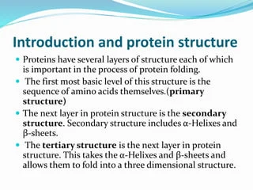

Slide 2
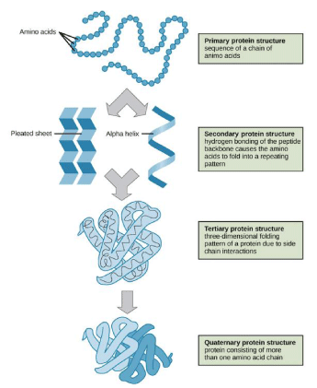

Slide 3


Slide 4
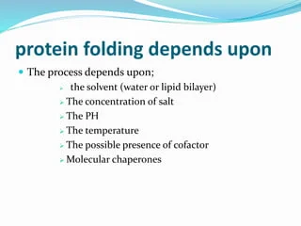

Slide 5
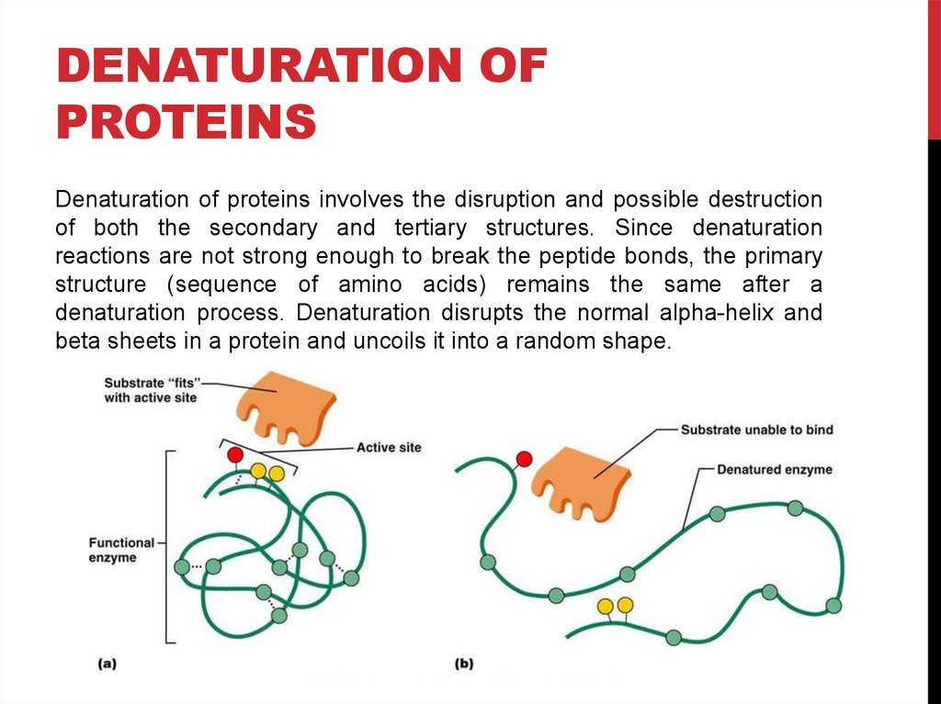
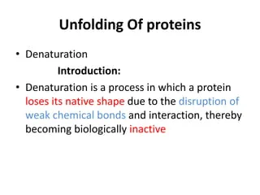

Slide 6
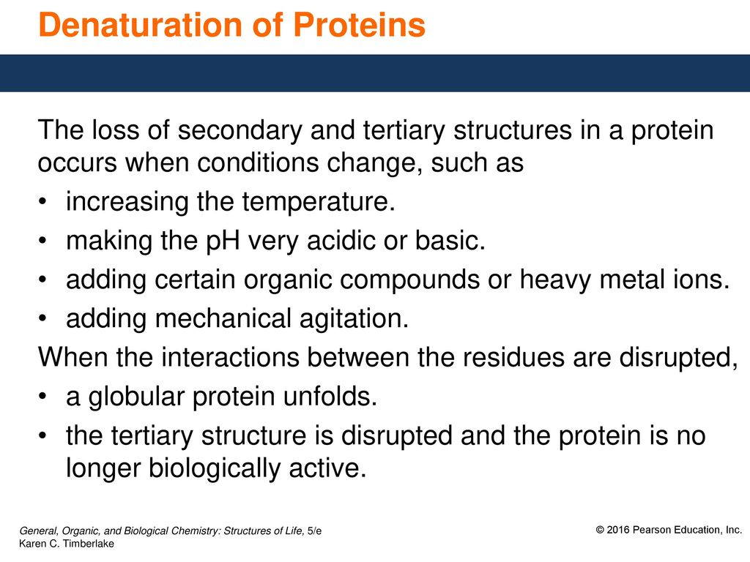

Slide 7
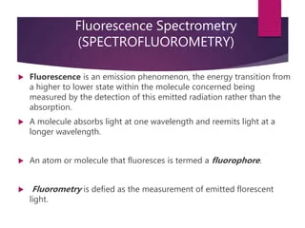

Slide 8
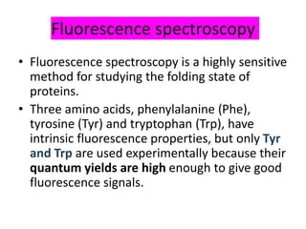

Slide 9
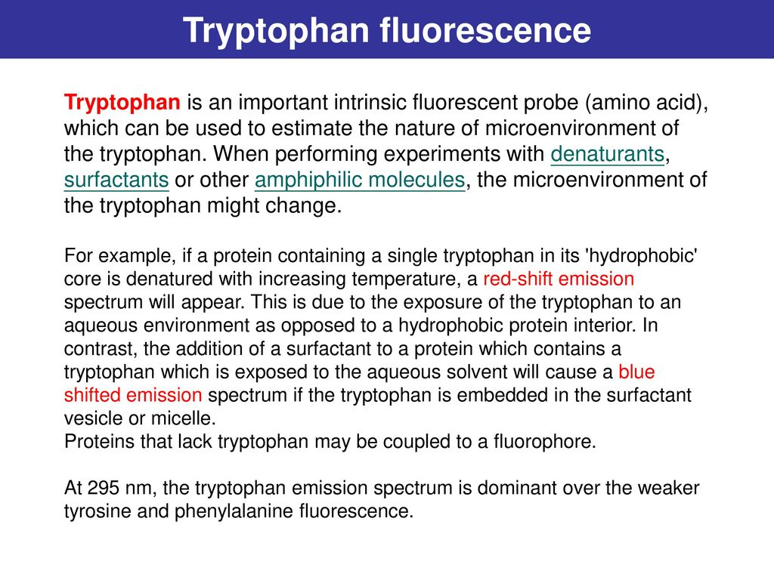

Slide 10
Equilibrium unfolding of bovine serum albumin monitored using tryptophan fluorescence
In this laboratory we monitor the equilibrium unfolding of bovine serum albumin by monitoring the fluorescence intensity of the lone Trp in the protein.
The Trp fluorescence intensity and emission wavelength serve as probes for the environment surrounding the Trp residue in the protein.
Bovine serum albumin is a serum albumin protein derived from cows. It is often used as a protein concentration standard in lab experiments.
BSA is a single polypeptide chain consisting of about 582 amino acid residues and no carbohydrates. At pH 5-7 it contains 17 intrachain disulfide bridges and 1 sulfhydryl group.
bovine serum albumin (BSA), which contains 582 amino acids, has two tryptophanyl residues (Trp214 and Trp135 located in subdomains IIA and IB, respectively)
The fluorescence of naturally occurring amino acids like tryptophan is a useful tool to study protein structure and function. Intrinsic tryptophan fluorescence can be used for example to look at conformational changes, measure enzyme activities, or investigate the binding of ligands.
Tryptophan is excited at wavelengths around 280 nm and emits fluorescence in a peak from 300-400 nm.

Slide 11
